Slide 1

PropagandaAI
Building applications with the power of
ChatGPT and DALL-E

Slide 2
Goal
A software application that allows users to input specific themes or topics for a meme or propaganda poster. Following this input, the application should be capable of autonomously generating relevant imagery and accompanying text. Subsequently, it should seamlessly integrate these elements to produce a cohesive poster

Slide 3
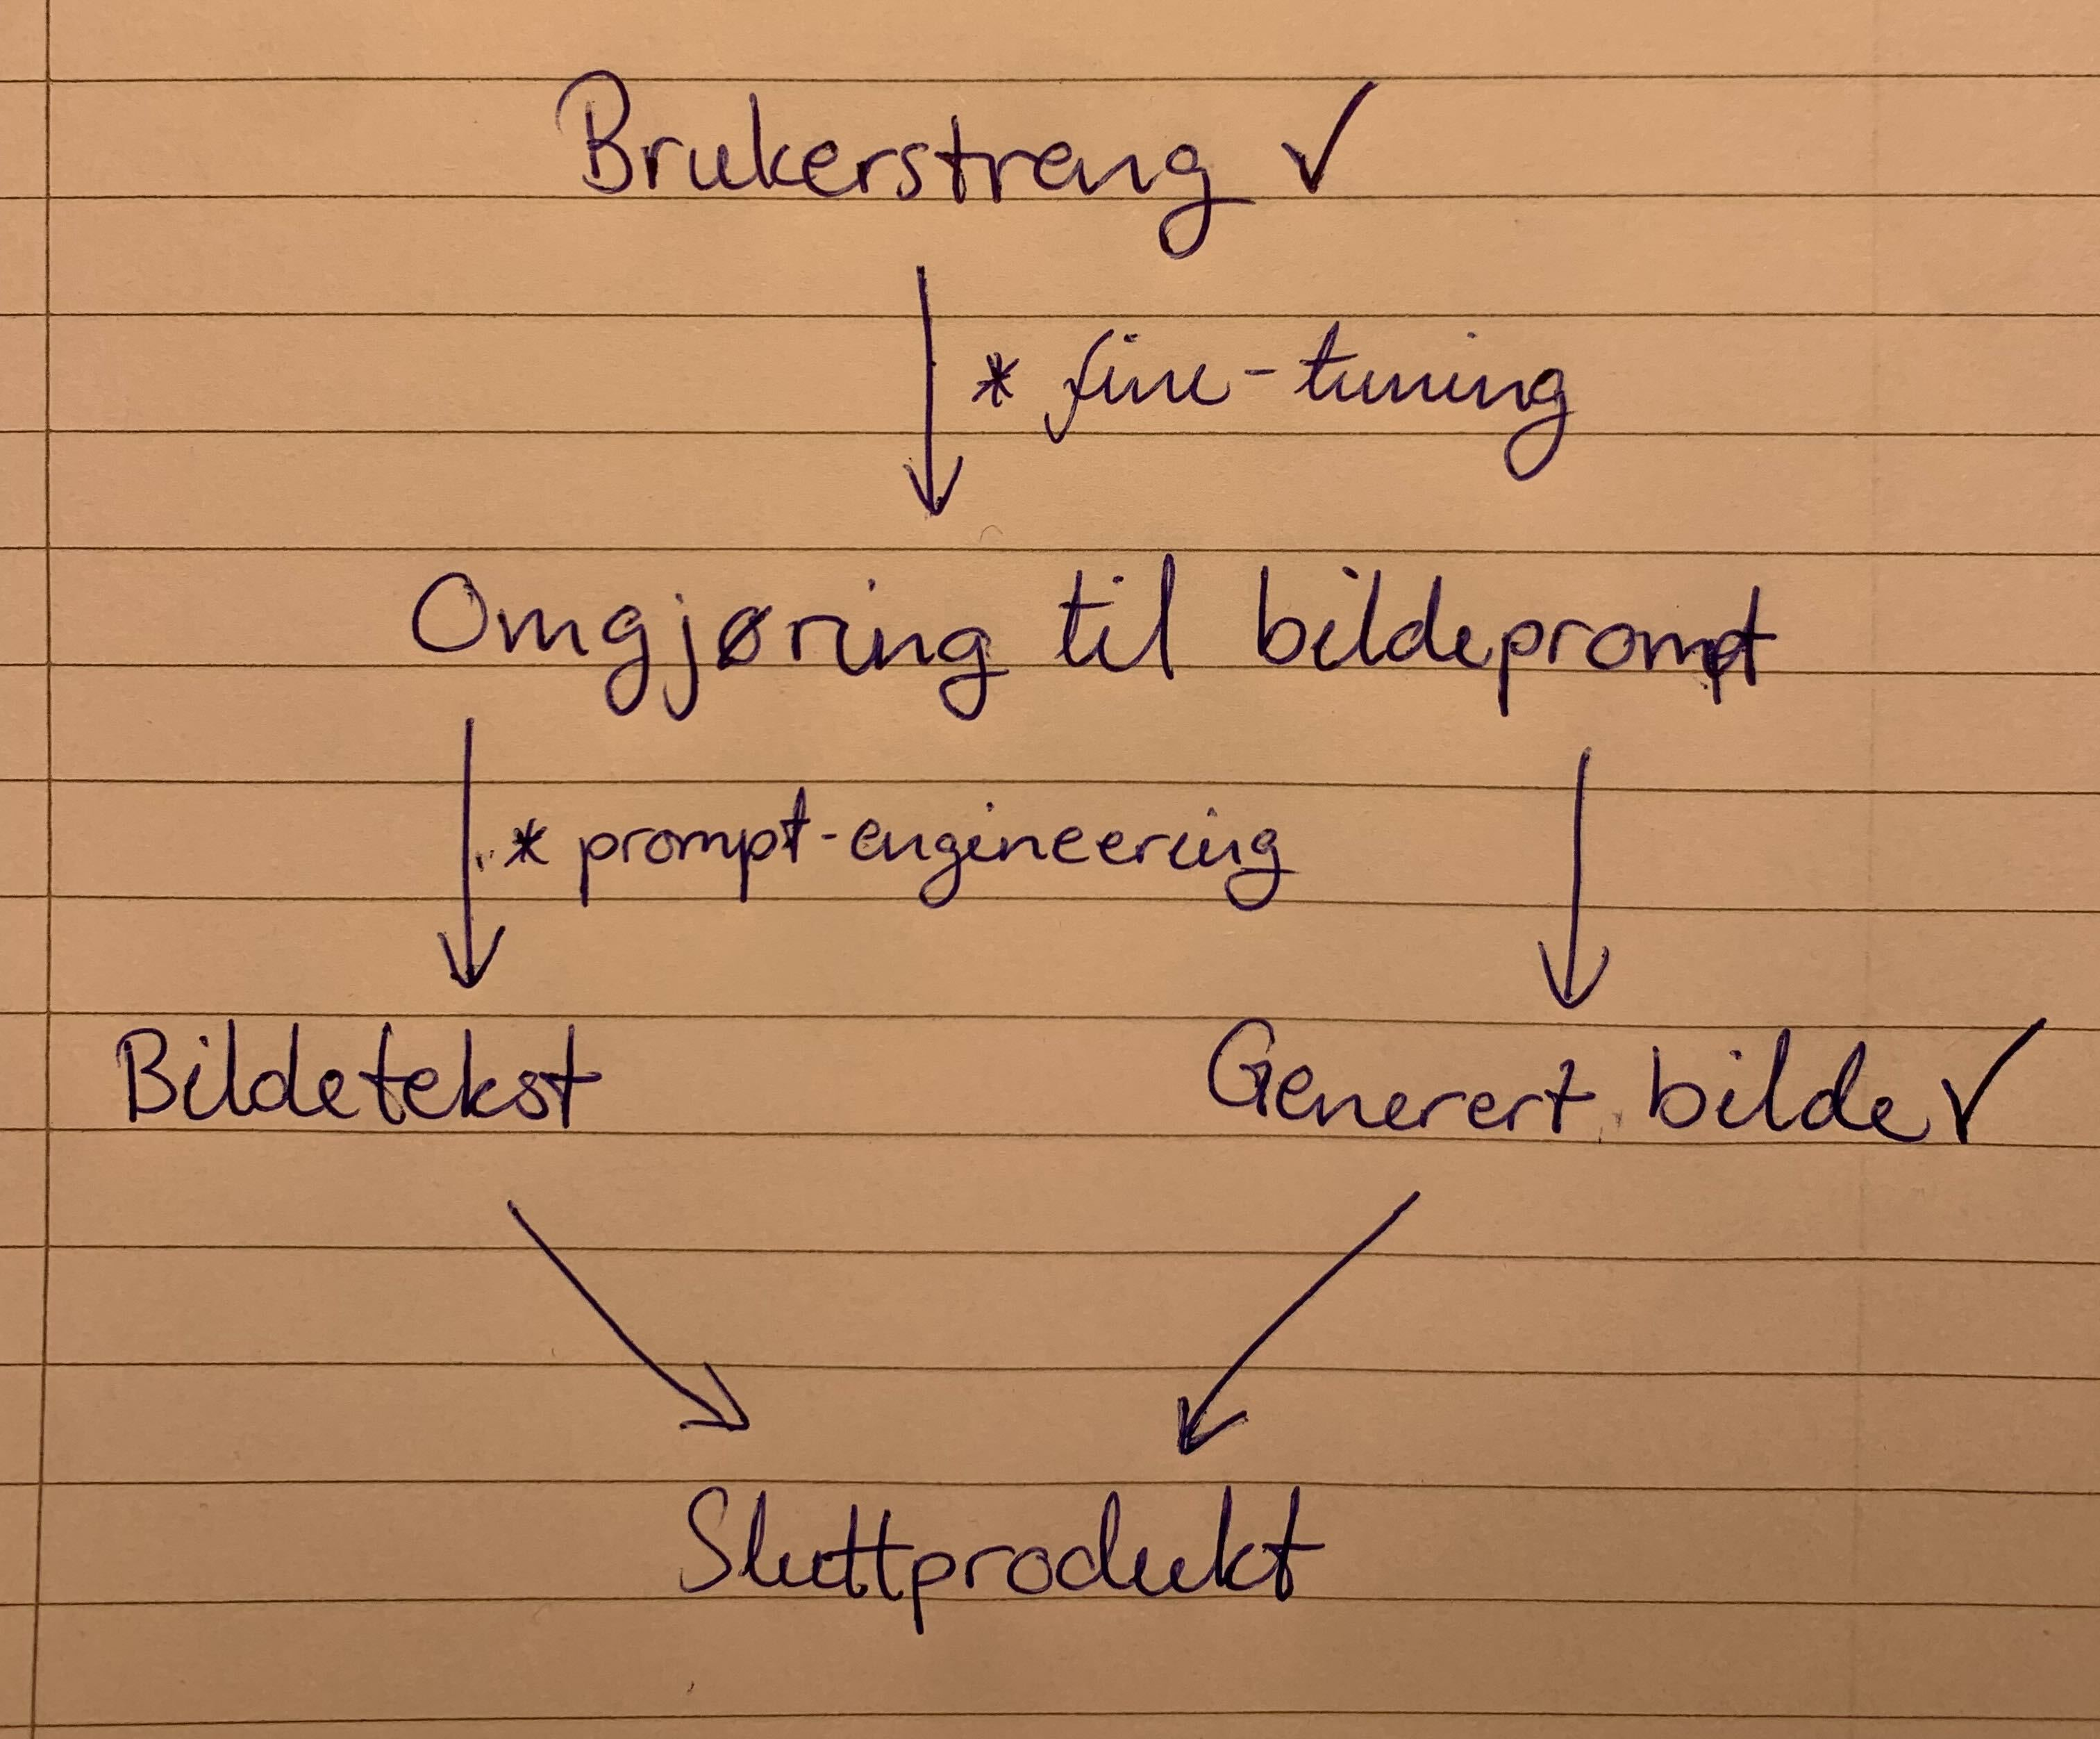
Systems overview

Slide 4
Progress & Future
What have we achieved:
User input
Integrated application with image and text generation technologies
Configuration and safe storing of API keys
Logging for observability
Image and text caption assembling
Created tests and CI system
Good pipeline and easy setup
Stated to create our own dataset for propaganda posters to finetune
Future goals:
Create more prompt templates for:
Propaganda, Meme and Marketing
Improve templates with prompt engineering
Gather more good prompts for finetuning
Create an “Auto Style” functionality
Use function calling to help in styling image caption
Create a frontend application using PropagandaAI and add it to the cogito website ☺

Slide 5
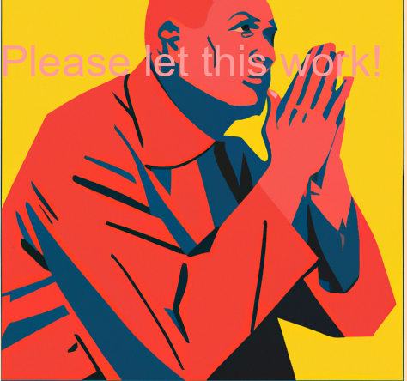
Practical demonstration

Slide 6

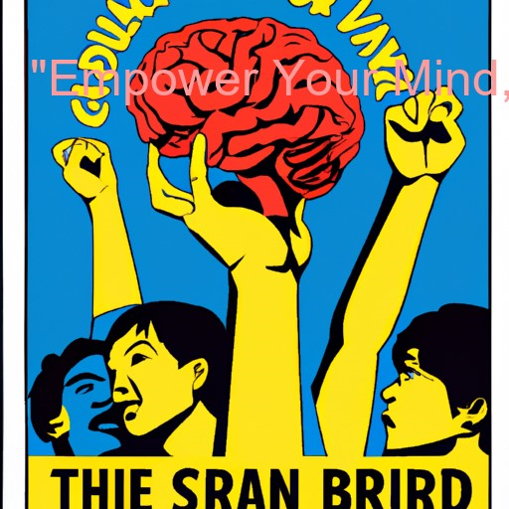

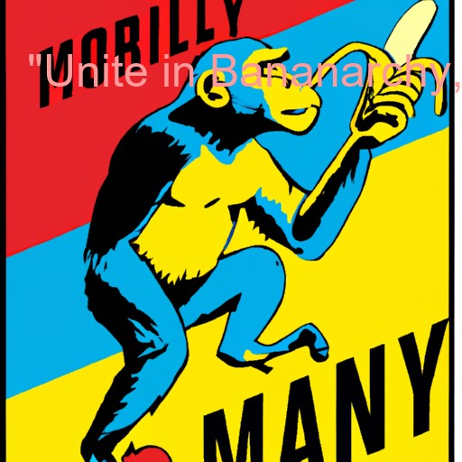
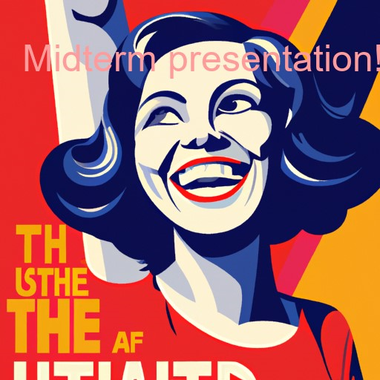
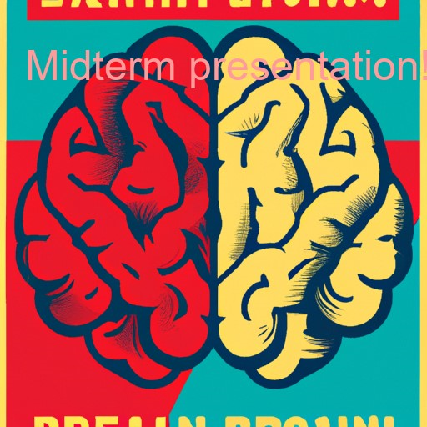
Q&A

